Slide 1
Cryptosystems
Computer Networks
CO-306 -Sourabh 2K18/CO/355 -Sunil Sahu 2k18/CO/363 Submitted to: -Prof Vinay Dubey

Slide 2

\It is an execution of cryptographic practice and their associated communications to offer information safety measures. It is also known as a cipher system.
INTRODUCTION

Slide 3
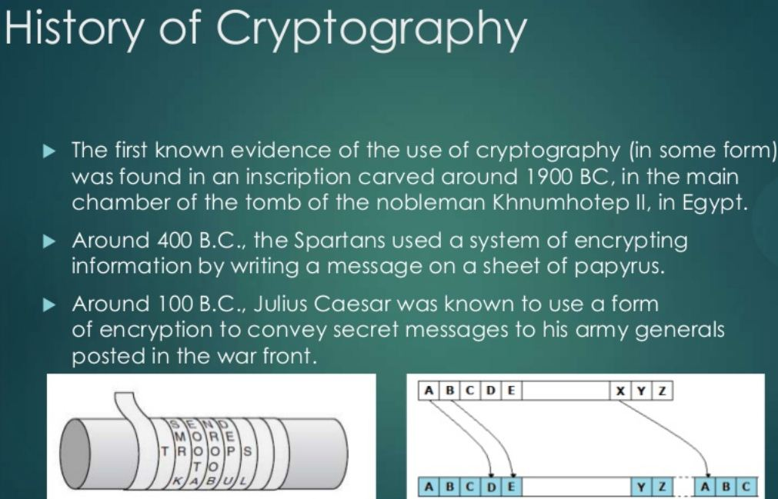

Slide 4
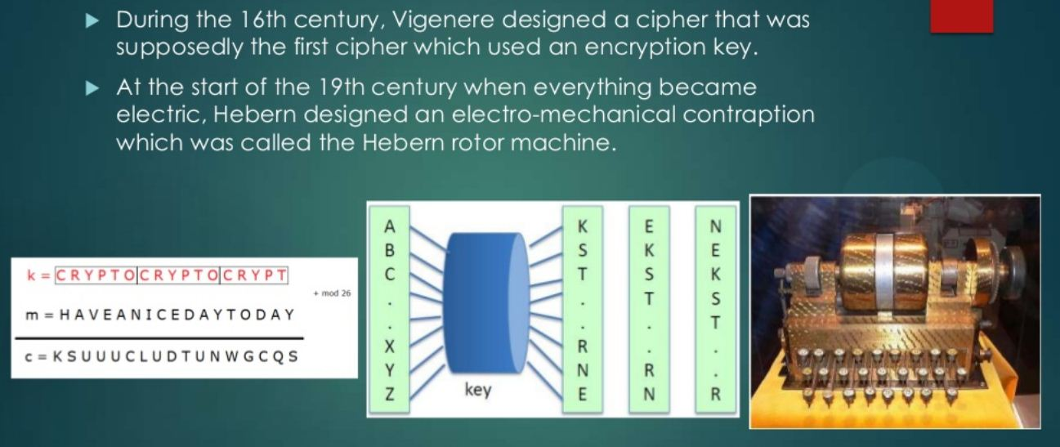

Slide 5
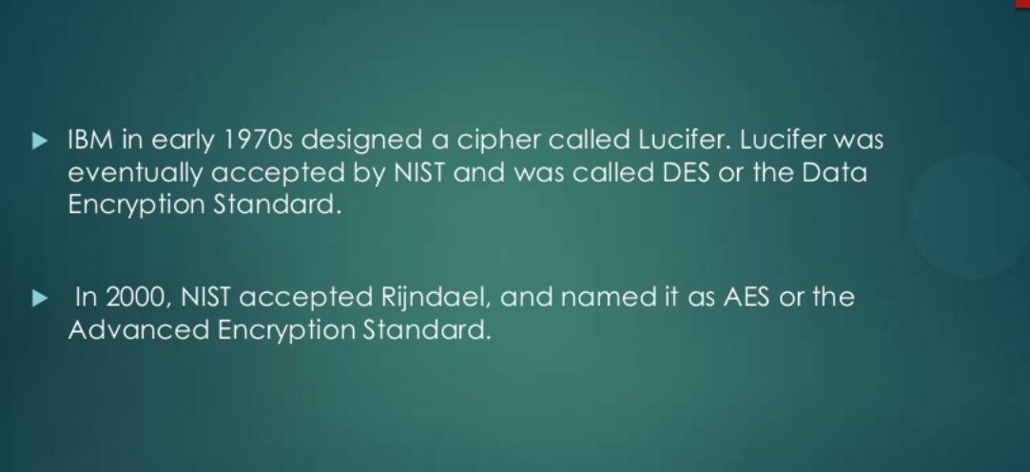

Slide 6

Purpose of Cryptosystem
Authentication: The process of proving one's identity. (The
primary forms of host-to-host authentication on the Internet
today are name-based or address-based, both of which are
notoriously weak.)
Privacy/confidentiality: Ensuring that no one can read the
message except the intended receiver.
Integrity: Assuring the receiver that the received message has
not been altered in any way from the original.
Non-repudiation: A mechanism to prove that the sender
really sent this message.

Slide 7

Components of a Cryptosystems

Slide 8
Plaintext. It is the data to be protected during transmission.
Encryption Algorithm. It is a mathematical process that produces a ciphertext for any given plaintext and encryption key. It is a cryptographic algorithm that takes plaintext and an encryption key as input and produces a ciphertext.
Ciphertext. It is the scrambled version of the plaintext produced by the encryption algorithm using a specific the encryption key. The ciphertext is not guarded. It flows on public channel. It can be intercepted or compromised by anyone who has access to the communication channel.

Slide 9
Decryption Algorithm, It is a mathematical process, that produces a unique plaintext for any given cipher text and decryption key. It is a cryptographic algorithm that takes a cipher text and a decryption key as input, and outputs a plaintext. The decryption algorithm essentially reverses the encryption algorithm and is thus closely related to it.
Encryption Key. It is a value that is known to the sender. The sender inputs the encryption key into the encryption algorithm along with the plaintext in order to compute the cipher text.

Slide 10
Decryption Key. It is a value that is known to the receiver. The decryption key is related to the encryption key, but is not always identical to it. The receiver inputs the decryption key into the decryption algorithm along with the cipher text in order to compute the plaintext.
For a given cryptosystem, a collection of all possible decryption keys is called a key space.
An interceptor (an attacker) is an unauthorized entity who attempts to determine the plaintext. He can see the ciphertext and may know the decryption algorithm. He, however, must never know the decryption key.

Slide 11
Types of Cryptosystems

Slide 12
Fundamentally, there are two types of cryptosystems based on the manner in which encryption-decryption is carried out in the system − 1. Symmetric Key Encryption 2. Asymmetric Key Encryption The main difference between these cryptosystems is the relationship between the encryption and the decryption key. Logically, in any cryptosystem, both the keys are closely associated. It is practically impossible to decrypt the cipher text with the key that is unrelated to the encryption key.

Slide 13
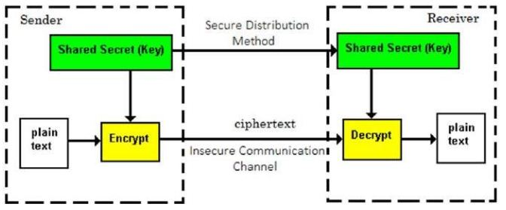
Symmetric Key Encryption
The encryption process where same keys are used for encrypting and decrypting the information is known as Symmetric Key Encryption.
The study of symmetric cryptosystems is referred to as symmetric cryptography. Symmetric cryptosystems are also sometimes referred to as secret key cryptosystems.
A few well-known examples of symmetric key encryption methods are − Digital Encryption Standard (DES), Triple-DES (3DES), IDEA, and BLOWFISH.

Slide 14
Features
Persons using symmetric key encryption must share a common key prior to exchange of information.
Keys are recommended to be changed regularly to prevent any attack on the system.
A robust mechanism needs to exist to exchange the key between the communicating parties. As keys are required to be changed regularly, this mechanism becomes expensive and cumbersome.
In a group of n people, to enable two-party communication between any two persons, the number of keys required for group is n × (n – 1)/2.
Processing power of computer system required to run symmetric algorithm is less.

Slide 15
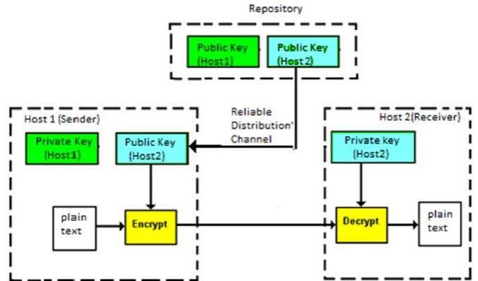
Asymmetric Key Encryption
The encryption process where different keys are used for encrypting and decrypting the information is known as Asymmetric Key Encryption. Though the keys are different, they are mathematically related and hence, retrieving the plaintext by decrypting cipher text is feasible.

Slide 16
Features
Every user in this system needs to have a pair of dissimilar keys, private key and public key. They are mathematically related − when one key is used for encryption, the other can decrypt the cipher text back to the original plaintext.
It requires to put the public key in public repository and the private key as a well-guarded secret. Hence, this scheme of encryption is also called Public Key Encryption.
Though public and private keys of the user are related, it is computationally not feasible to find one from another. This is a strength of this scheme.
Length of Keys (number of bits) in this encryption is large and hence, the process of encryption-decryption is slower than symmetric key encryption.
Processing power of computer is required to run this algorithm is higher.

Slide 17
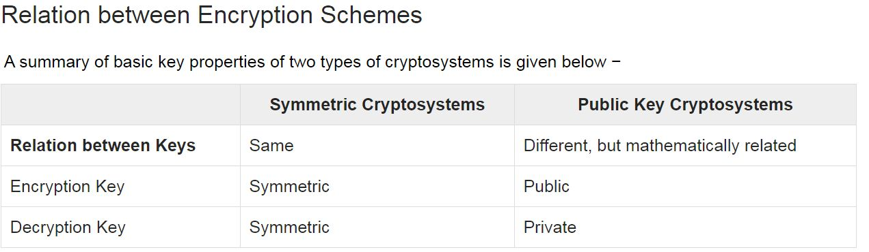
Organizational Structure

Slide 18

DES The Data Encryption Standard (DES) is a symmetric-key block cipher published by the National Institute of Standards and Technology (NIST). DES is an implementation of a Feistel Cipher. It uses 16 round Feistel structure. The block size is 64-bit. Though, key length is 64-bit, DES has an effective key length of 56 bits, since 8 of the 64 bits of the key are not used by the encryption algorithm (function as check bits only).

Slide 19
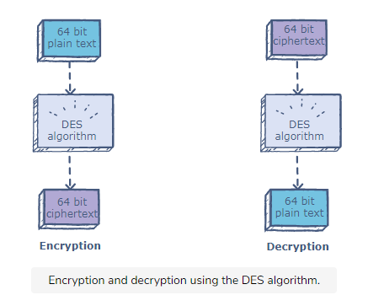
1. Generating keys
2. Encrypting plain text to obtain cipher text
3.Decrypting cipher text to obtain plain text

Slide 20
Steps for generating KEYS
Compress and transpose the given 64-bit key into a 48-bit key
Divide the result into two equal parts: C and D.
C and D are left-shifted circularly. For encryption rounds 1, 2, 9, and 16 they are left shifted circularly by 1 bit; for all of the other rounds, they are left-circularly shifted by 2.
The result is compressed to 48 bits

Slide 21
Steps for Encryption
Transpose the bits in the 64-block
Divide the result into equal parts: left plain text (1-32 bits) and right plain text (33-64 bits)
The resulting parts undergo 16 rounds of encryption in each round.
The expanded right plain text now consists of 48 bits and is XORed with the 48-bit key.
The result of the previous step is divided into 8 boxes. Each box contains 6 bits
XOR the left half with the result from the above step. Store this in the right plain text.
Store the initial right plain text in the left plain text.
These halves are inputs for the next round. Remember that there are different keys for each round.
After the 16 rounds of encryption, swap the left plain text and the right plain text.
Finally, apply the inverse permutation (inverse of the initial permutation), ​and the ciphertext will be generated.

Slide 22
Steps for Decryption
The order of the 16 48-bit keys is reversed such that key 16 becomes key 1, and so on. Then, the steps for encryption are applied to the ciphe rtext.

Slide 23
RSA RSA algorithm is asymmetric cryptography algorithm. Asymmetric actually means that it works on two different keys i.e. Public Key and Private Key. As the name describes that the Public Key is given to everyone and Private key is kept private. It is named after those who invented it in 1978: Ron Rivest, Adi Shamir, and Leonard Adleman.

Slide 24
How it Works
1. Generating the keys
a) Select two large prime numbers, x and y.
b) Calculate n = (x*y).
c) Calculate the totient function; phi(n) = (x-1)(y-1)
d) Select an integer e should not be a factor of n, such that e is co-prime to phi(n) and 1<e<phi(n) .
e) calculate phi(n): Such that phi(n) = (P-1)(Q-1)
f) Calculate d such that e.d = 1 mod phi(n).
g) Now private key d = (k*phi(n) + 1) / e for some integer k
2. Encryption
Given a plaintext P, represented as a number, the ciphertext C is calculated as:
C = P^e mod n
3. Decryption
Using the private key (n,d), the plaintext can be found using:
P = C^d mod n

Slide 25
Thank You !
SOURABH
2K18/CO/355
SUNIL SAHU
2K18/CO/363

